Slide 1
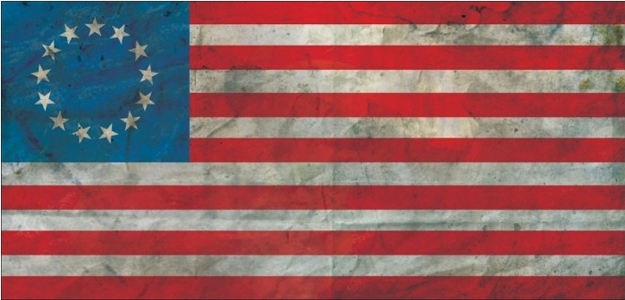
The American Revolution
1775 - 1783
Notes:
US DVD Clip (4)

Slide 2
Key Questions
What problems did the American colonists have with Great Britain?
Why did colonial loyalists oppose the revolution?
What makes the Bill of Rights so important?

Slide 3
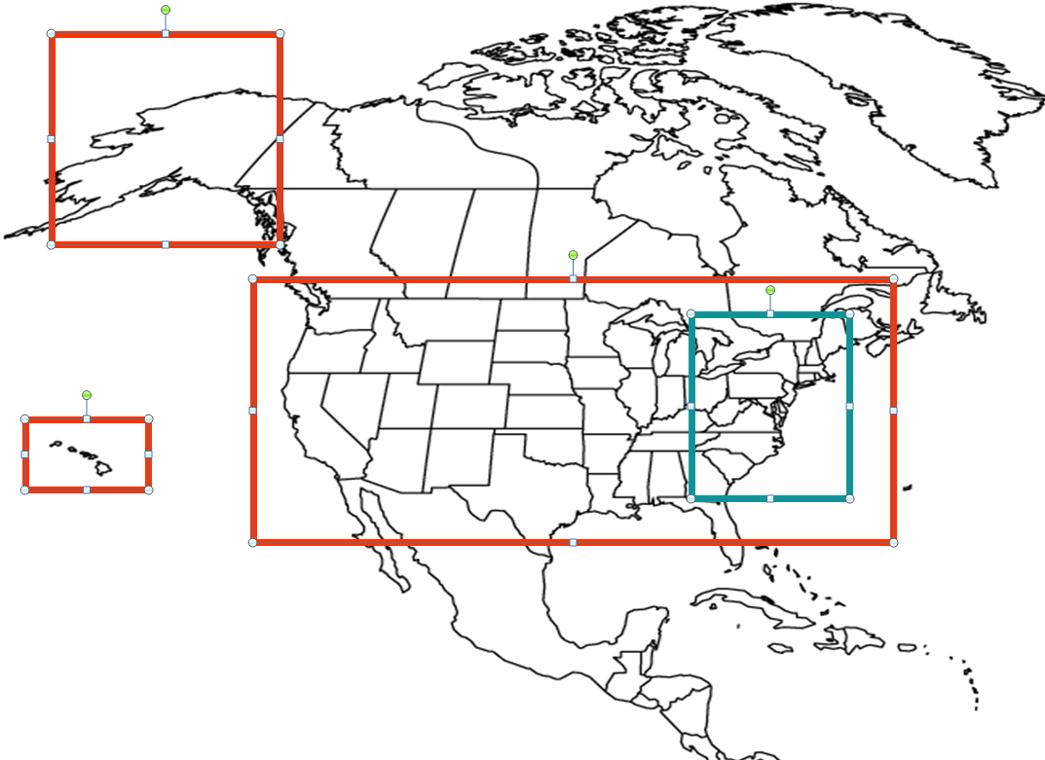
Now vs Then

Slide 4
Taxation
1754-1763 – “French and Indian War”
British vs France
British victory and expansion of British colonies in North America
Good news vs Bad news
No more French threat to colonists
Colonists had to pay more taxes to cover the war

Slide 5
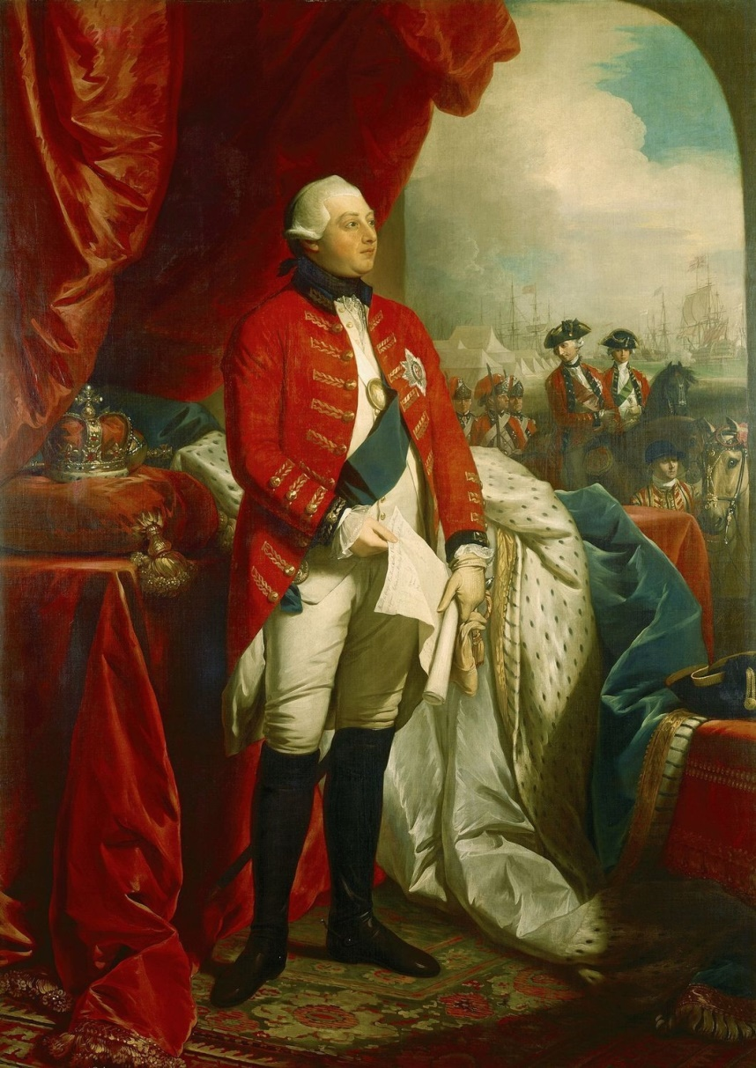
Taxation (cont)
King George III and Parliament agree to tax the colonies
Colonial citizens have no say over their taxation or the laws that govern them

Slide 6
“Pizza Theory of Taxes”
Everyone pitches in to buy a pizza, but only one person chooses what to put on it
Is it fair?
Why or why not?

Slide 7
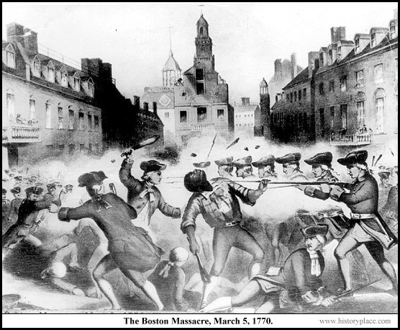
Boston Massacre
March 5th, 1770
Violent protests lead to a shootout between colonists and British troops

Slide 8
Tea Act of 1773
The Tea Act of 1773 was to bail out the British shipping company, the East India Company
It was intended to stop illegally smuggled tea from coming into the colonies
Colonists did not agree with the new law, leading to the Boston Tea Party.

Slide 9
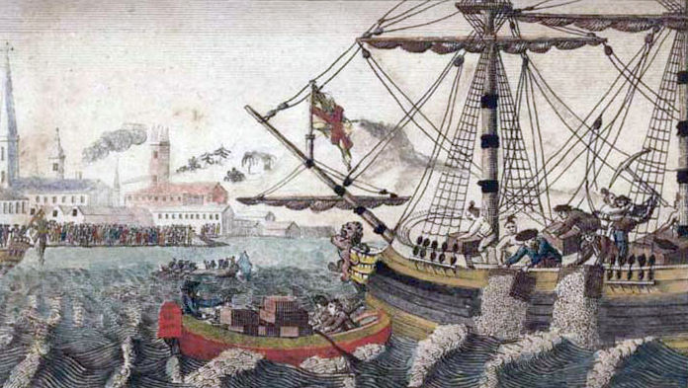
Boston Tea Party
December 16th, 1773
The Sons of Liberty (colonists) dressed up as Native Americans
Boarded East India Company ships in the Boston harbor and threw crates of tea overboard
Because of these actions, Britain imposed more harsh laws on the colonies

Slide 10
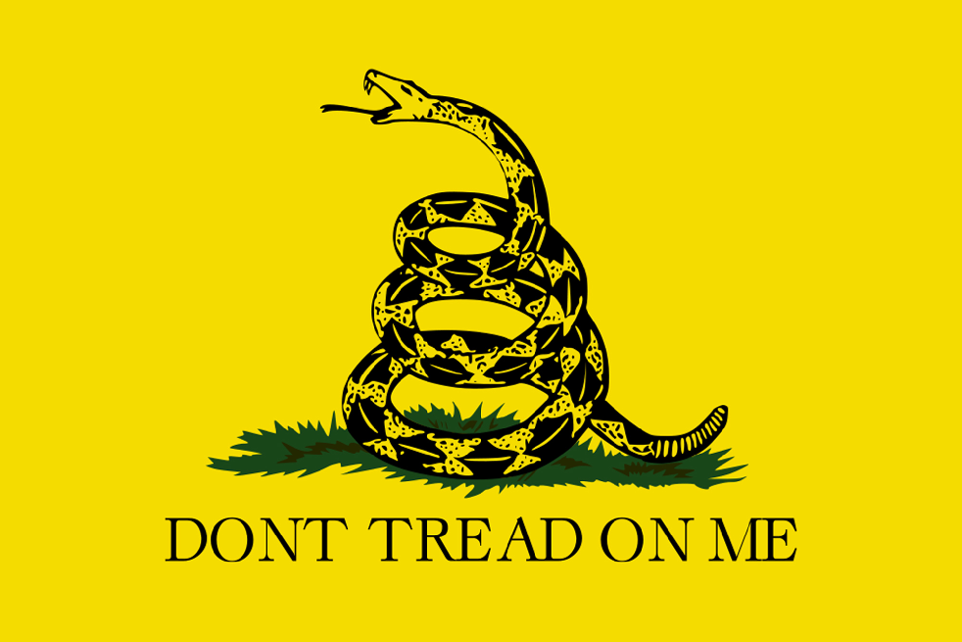

Slide 11
Forming a Congress
September 1774 - Representatives from each colony gathered in Philadelphia
They formed the first Continental Congress
Other well known colonists attended the meeting
Here, they wrote the Bill of Rights
Was to legally enforce basic human rights for the colonists
The amendments in the Bill of Rights would later be carried over to the U.S. Constitution
Did not apply to slaves or women

Slide 12
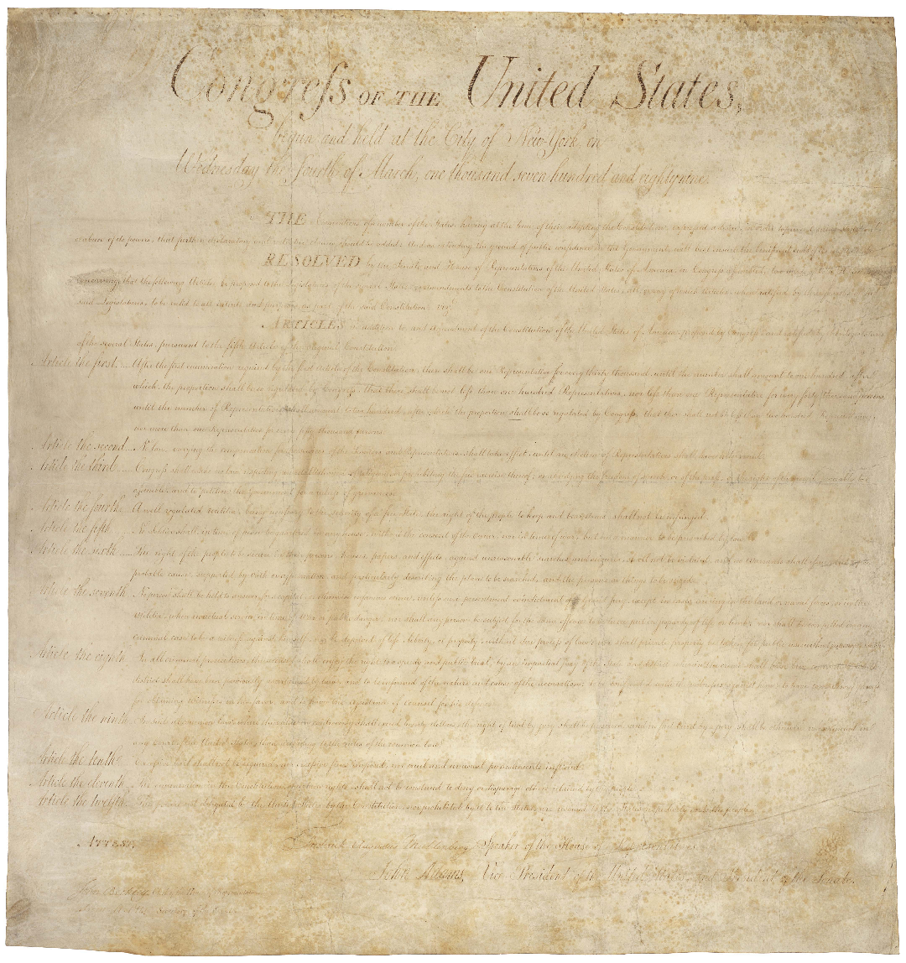
Bill of Rights

Slide 13
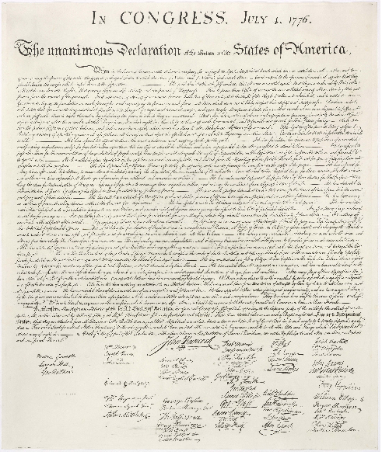
Declaring Independence
July 4th, 1776
Second Continental Congress meeting
The Declaration of Independence was written as a list of grievances against Britain.
Officially stated that the colonies were free and at war with Britain
“We hold these truths to be self-evident, that all men are created equal, that they are endowed by their Creator with certain unalienable Rights, that among these are Life, Liberty and the pursuit of Happiness.”
https://www.youtube.com/watch?v=EGgaXXBkE8A

Slide 14
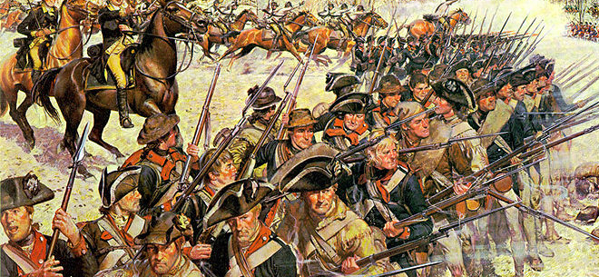
The Americans
George Washington led the Continental Army
The Minutemen were colonist militia members
Farmers, workmen, etc
“Ready at a minute’s notice”

Slide 15
Fight for Revolution
1775
Battles of Lexington and Concord (1st battles)
Bunker’s Hill (Close quarters)
1776
Trenton (Crossing the Delaware)
1777
Saratoga (Turning point with French aid)
1781
Yorktown (Final Battle)
https://www.youtube.com/watch?v=rj2U1SNIYbk

Slide 16
Difficulties
Loyalists
Not all colonists opposed Britain
Britain offered aid to loyalists
Less loyalists participated in the war than promised
When the war was over, some loyalists fled to Britain and Canada
Other loyalists remained in the newly formed U.S.A.

Slide 17
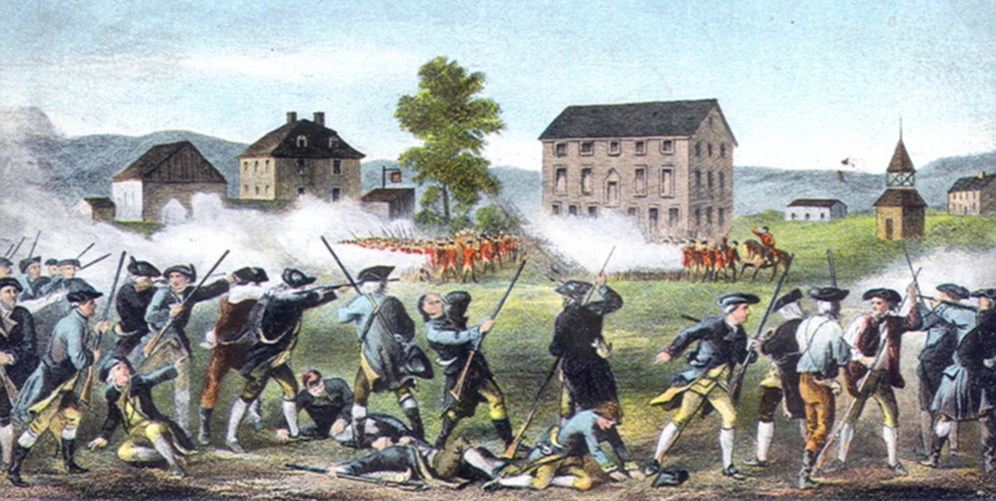
Fight for Revolution

Slide 18
Faces of Revolution
George Washington
Virginia Planter and General of the Continental Army
Thomas Jefferson
Author of the Declaration of Independence
James Madison
Drafted the U.S. Constitution
Benjamin Franklin
Created the postal system

Slide 19
Outcome
Death Toll
Over 25,000 Americans colonists
Over 40,000 British troops and sailors
Articles of Confederation
The “original” constitution
Too weak and replaced by the Constitution
The Constitution created a federal republic
Enforced the idea of a popular sovereignty
Treaty of Paris (1783)
Officially ended the war and forced Britain to recognize the United States as an independent nation

Slide 20
Outcome (cont)
A new nation
The United States of America
Formed by 13 former colonies of Britain
New tensions between Britain and France
The American Revolution becomes a model for other colonial locations
A chain of revolutions around the world

Slide 21
End
QUESTIONS???

